Slide 1

Keyloggers-
Capturing Key Strokes
By-Priyanshu Semwal

Slide 2

PROBLEM STATEMENT
In today’s digital world, user interaction with systems mainly happens through keyboards. Understanding how keystrokes are generated, captured, and stored at the system level is important for learning computer security, ethical hacking awareness, and defensive programming.
How keystroke data flows from input devices to applications
How malicious software like keyloggers operate
How security professionals detect and prevent such threats
This project aims to study and demonstrate the concept of keylogging in a controlled and ethical environment for educational purposes only, helping students understand both offensive techniques and defensive security measures.

Slide 3
Project Description
The project “Keyloggers – Capturing Keystrokes” is an educational implementation that demonstrates how keyboard inputs can be captured and stored using Python. It uses a simple graphical interface to start the logging process and records keystroke events in text and JSON formats, helping learners understand input handling, file storage, and cybersecurity concepts.
Key Highlights:
Captures key press, hold, and release events
Stores keystrokes in text and JSON files
Uses Python and Tkinter for GUI
Designed for educational and ethical learning purposes

Slide 4

WHO ARE THE END USERS?
The end users of this project include:
Students learning:
  Cyber Security
  Ethical Hacking
  System Programming
  Python Programming
Faculty members for academic demonstration
Security learners who want to understand how keylogging attacks work
Researchers studying malware behavior for detection and prevention
The project is strictly intended for educational and research purposes only.

Slide 5

Technology Used
Programming Language: Python
GUI Framework: Python GUI (Tkinter)
Operating System: Windows
File Handling: Text-based log storage
Concepts Used:
  Keyboard input monitoring (conceptual)
  Event handling
  File operations
  GUI design
  Cybersecurity awareness

Slide 6
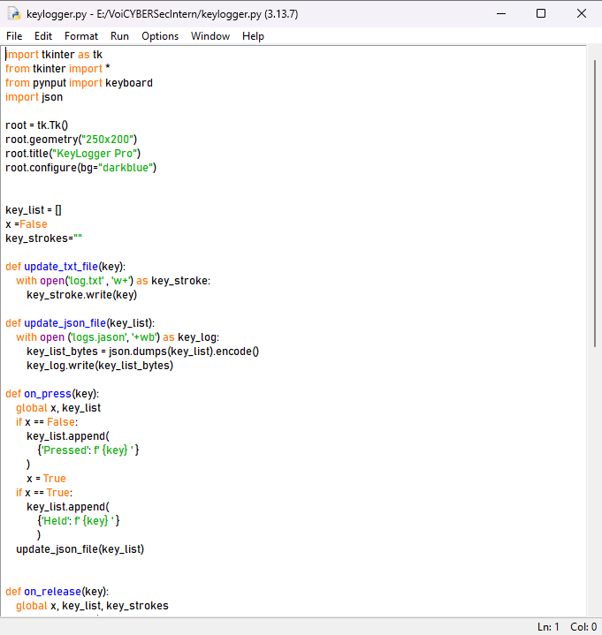
RESULTS
Demo Link

Slide 7
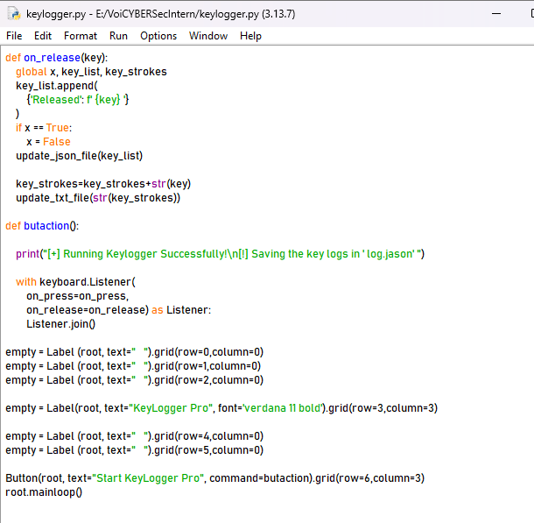
RESULTS
Demo Link

Slide 8
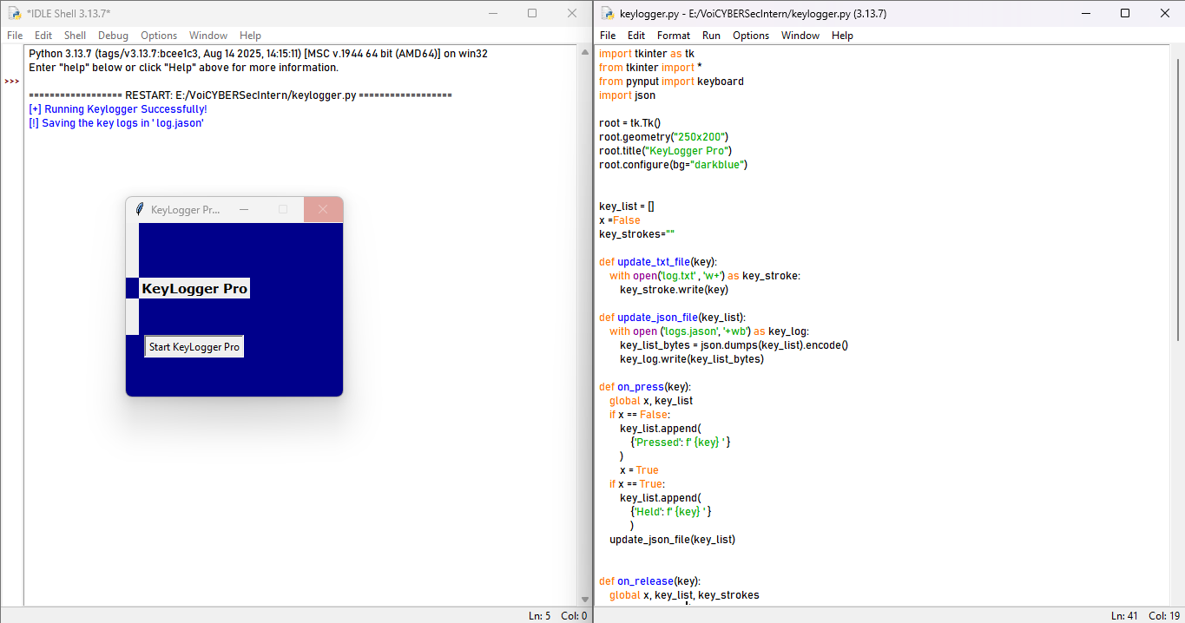
RESULTS
Demo Link

Slide 9
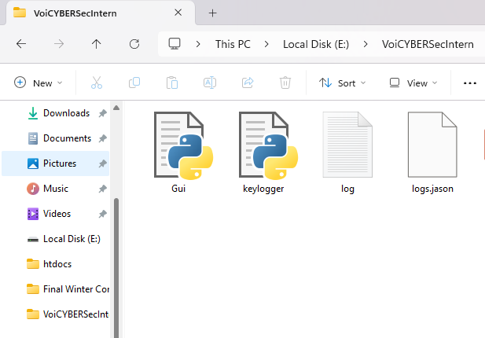
RESULTS
Text File
Json File
Demo Link

Slide 10
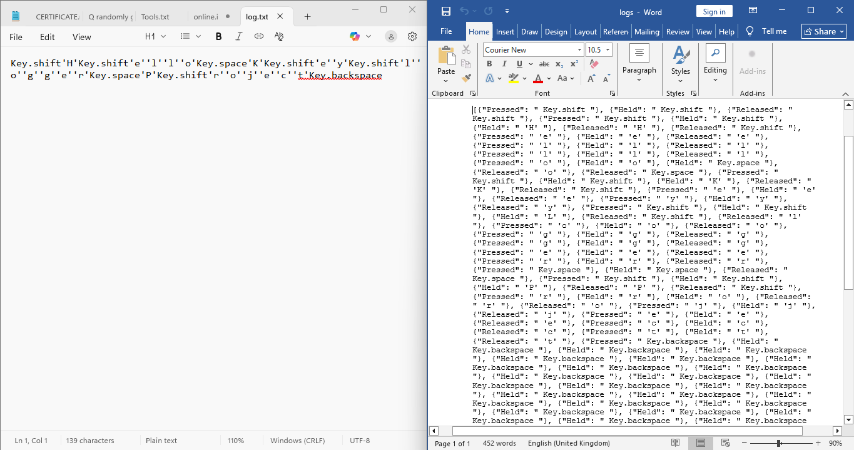
RESULTS
Text file
Json file
Demo Link

Slide 11
Thank you
Thank you for your valuable time and attention.
This project was developed as part of our academic learning to understand keylogging concepts, system input handling, and cybersecurity awareness.
.
.

